Slide 1
Zomato
Exploratory Data Analysis

Slide 2
Goal of Analysis
The goal is to identify and understand the patterns and trends in dining preferences across various Indian cities to guide targeted marketing strategies.

Slide 3
About Dataset
The dataset consists of 211,944 entries, with each entry corresponding to a restaurant. It encompasses a wide range of restaurants from different cities throughout India, ensuring geographic diversity. Each restaurant in the dataset is identified by a unique identifier. The dataset categorizes the dining establishments into various types, such as Quick Bites, Casual Dining, and Cafes. It includes comprehensive location details such as address, city, and locality. Additionally, latitude and longitude data are provided for mapping and spatial analysis. The dataset also details the types of cuisines served, such as Indian and Italian, and includes the typical operating hours of each restaurant.

Slide 4
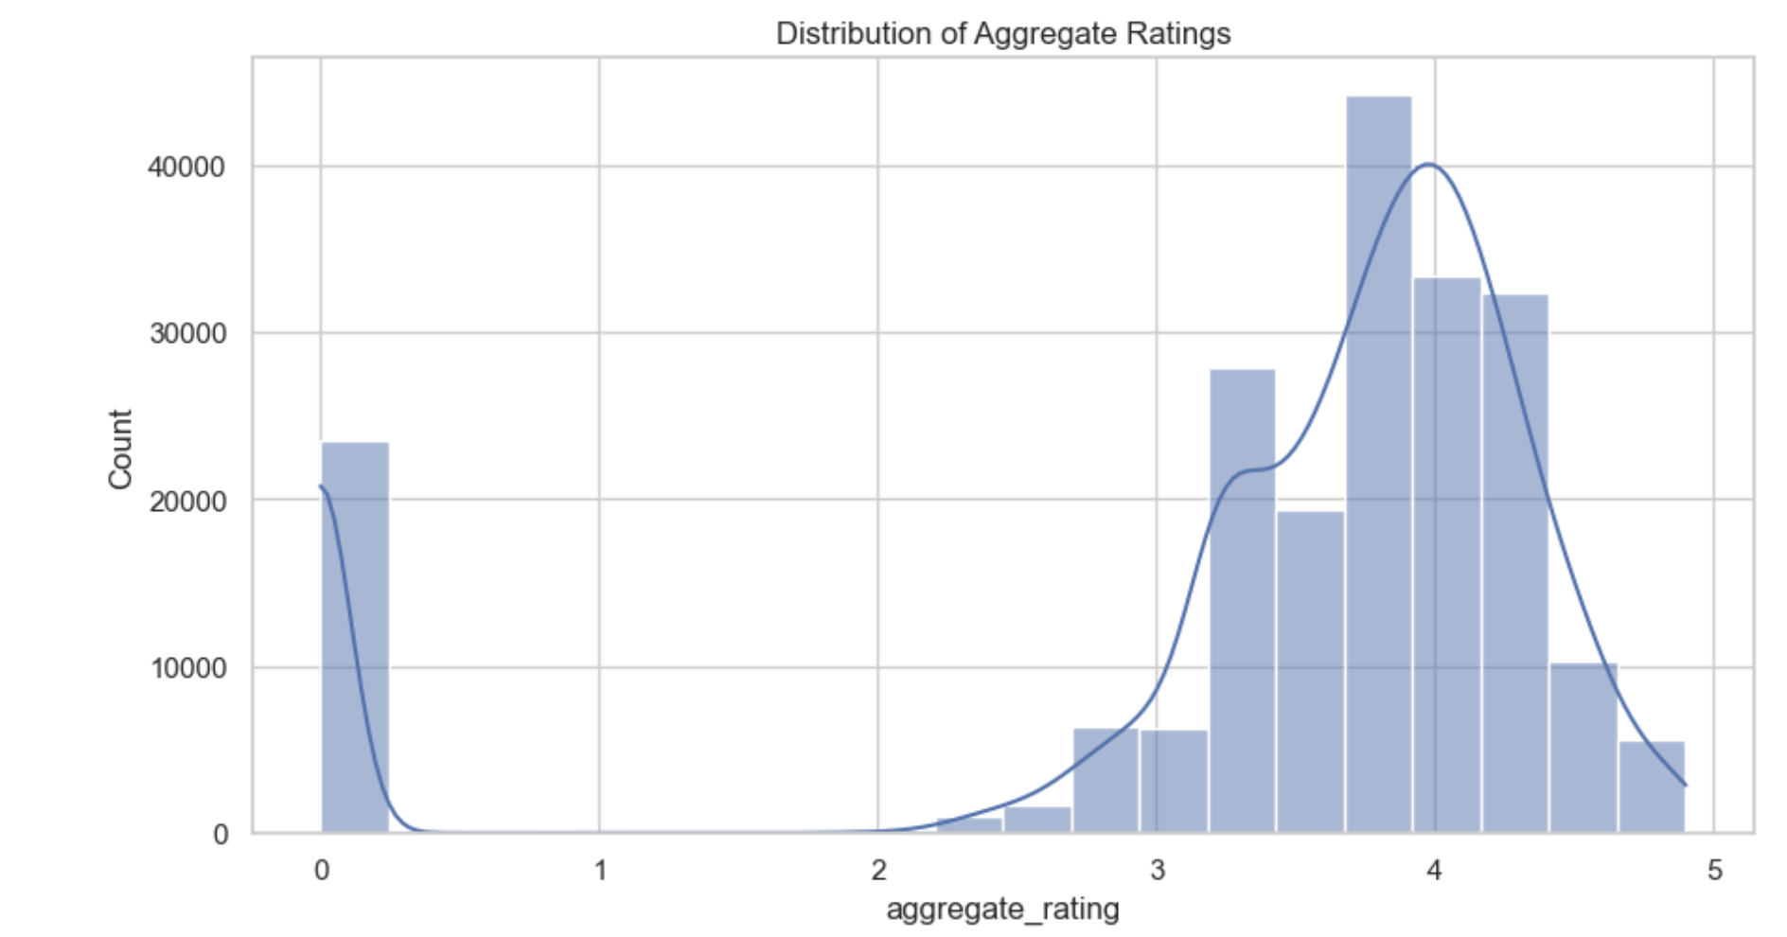
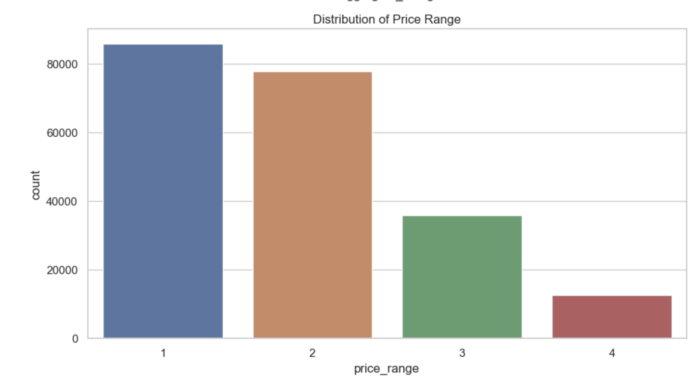
Data Cleaning and Exploration
Sorted missing values:
data['address'].fillna('Unknown', inplace=True): This command fills any empty entries in the 'address' column with the string 'Unknown'. data['timings’]. fillna('Not available', inplace=True): This command substitutes missing values in the 'timings' column with 'Not available'. data['cuisines’]. fillna(data['cuisines'].mode()[0], inplace=True): This fills empty spaces in the 'cuisines' column with the most common cuisine listed in the dataset, ensuring each restaurant has a cuisine type specified.
Data Transformation:
data['votes'] = data['votes'].apply(lambda x: max(x, 0)): This line uses a lambda function to ensure that all entries in the 'votes' column are non-negative by replacing any negative values with zero.
import ast: This statement imports the ast module, which is utilized for processing the Python abstract syntax grammar trees.
data['establishment'] = data['establishment'].apply(ast.literal_eval): This line applies ast.literal_eval to convert string representations of lists in the 'establishment' column into actual Python list objects.

Slide 5
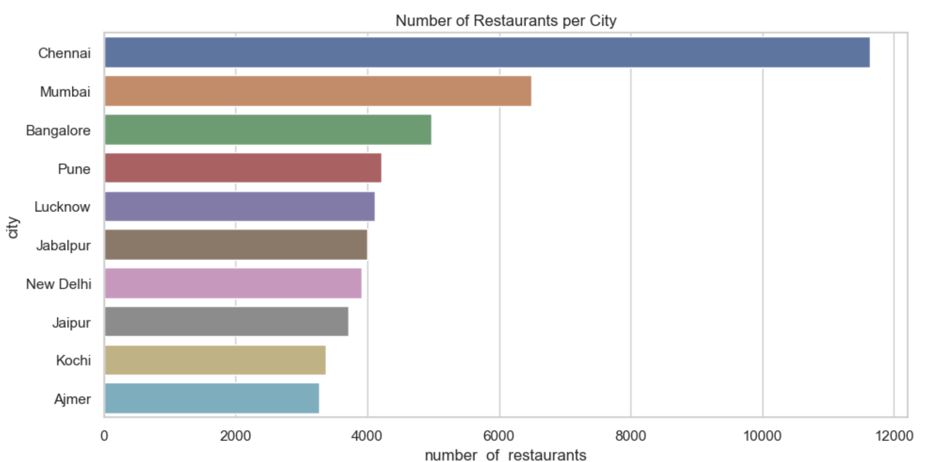
Regional Analysis

Slide 6
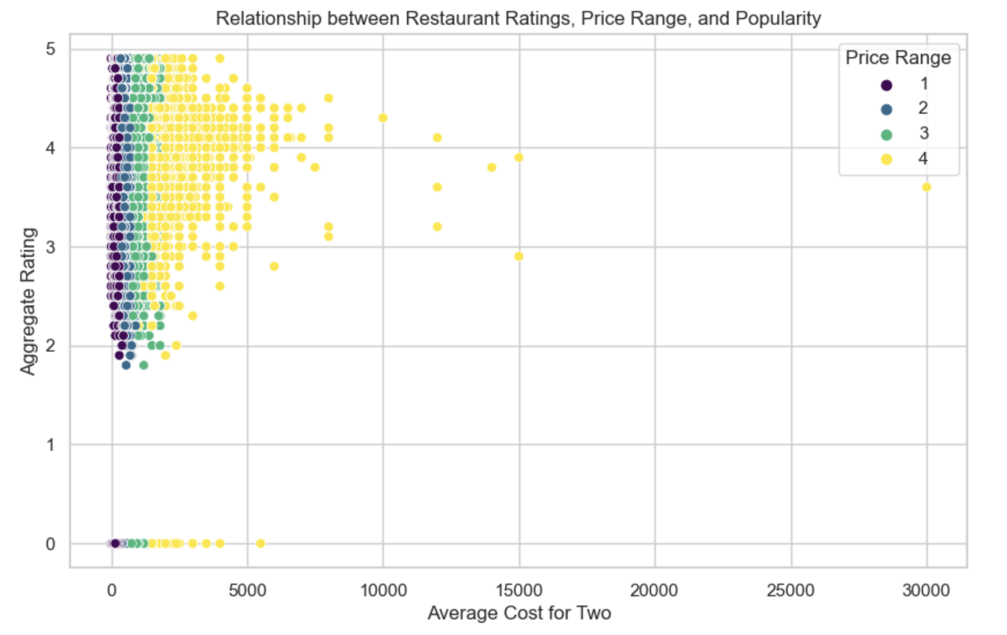
Customer Preference Analysis:

Slide 7
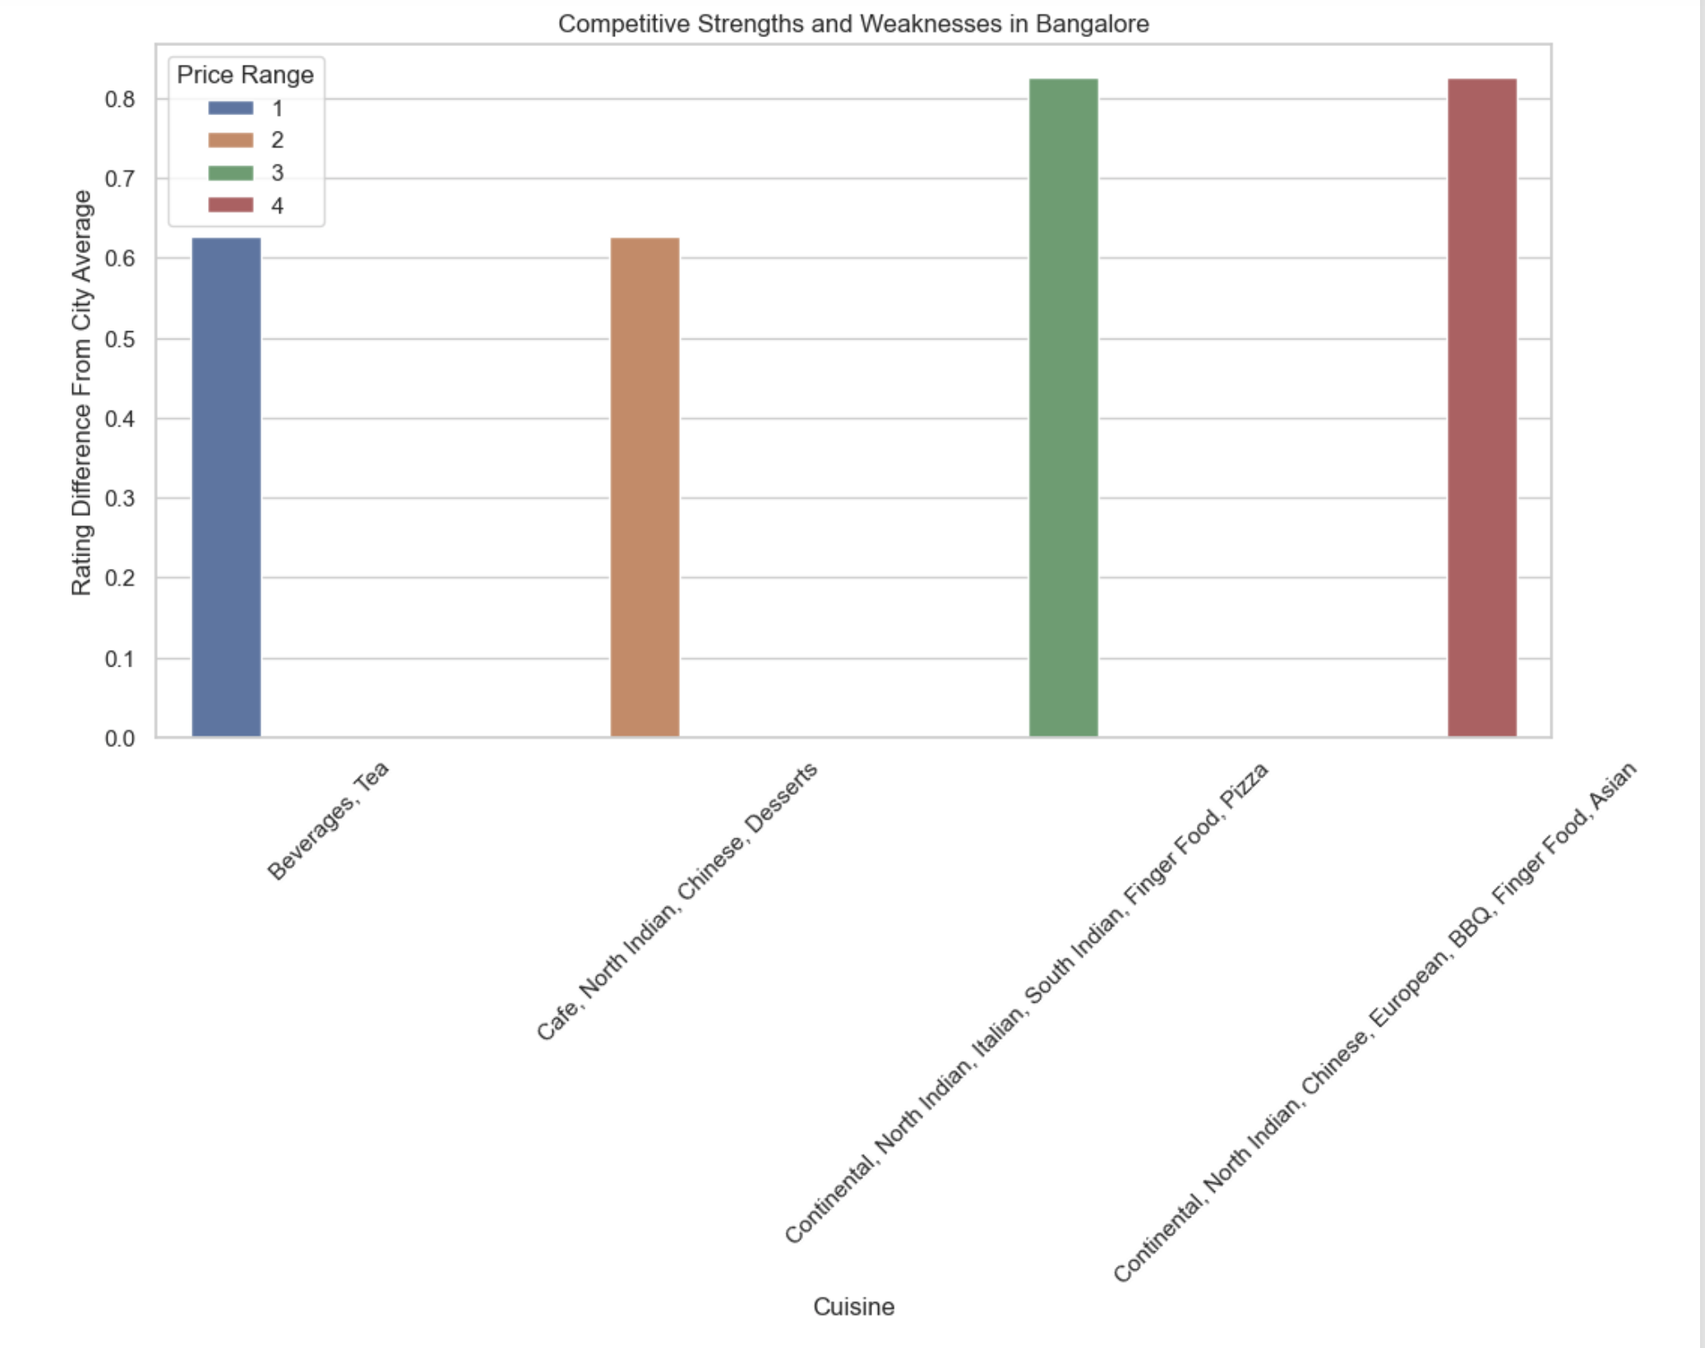
Competitive Analysis:

Slide 8
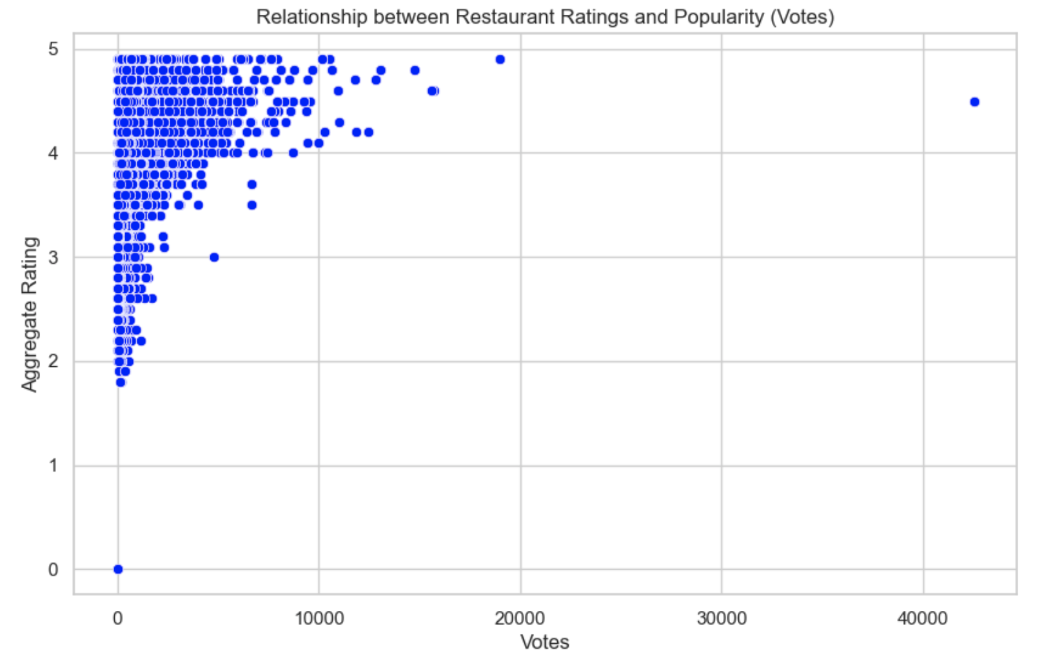
Market Analysis:

Slide 9

Conclusion
The analysis revealed considerable differences in preferred cuisines across various cities, highlighting how regional preferences and cultural distinctions greatly affect dining choices. For example, the most favored cuisine in each city often mirrors the local culinary practices or the demographic composition of the region. Marketers and new dining establishments can use this knowledge to customize their menus to better suit local tastes.
The scatterplot analysis comparing restaurant ratings with the average cost for two, distinguished by price range, indicates that restaurants with higher prices tend to receive better ratings. This correlation may stem from the perceived or actual quality of food and service in more expensive establishments. This pattern suggests that positioning themselves in a higher price bracket could be an effective strategy for restaurants seeking to signal quality. However, to maintain customer satisfaction, any increase in prices must be justified by corresponding improvements in quality.
The positive correlation between the number of votes (indicative of popularity) and aggregate ratings shows that restaurants with higher popularity usually receive better ratings. This relationship implies that greater customer satisfaction may enhance a restaurant's popularity via word-of-mouth and repeat business.

